Slide 1
MetaImage
Visual Metaphors Across Languages
Manh Linh Phan
Supervisor: Yindong Wang
Notes:
Hi, everyone. Welcome to the final presentation of my topic MetaImage.

Slide 2
Motivation
This project aims to explore how well image models can interpret and generate images from metaphorical language in two different languages.
Experiment:
- 4 image generation models
- 3 CLIP models.
Goal
Notes:
Our goal is to evaluate how well image generation models can understand the prompts and generate images that accurately visualize these prompts. We are going to explore both proprietary and open-source models. We will measure the similarity between text and image, as well as between different images.
We will experiment with 4 image models and 3 CLIP models

Slide 3
Image Generation Models
Stable Diffusion 1.5:
October 2022, 1 billion parameters
512x512 resolution
Stable Diffusion XL:
July 2023, 3.5 billion parameters
1024x1024 resolution
Stable Diffusion Cascade
Feb 2024
ChatGPT-4o:
DALL·E 3: close-sourced, supposedly quite larger
Modular (text and pixel generation) 1.7 - 5.1 billion parameters
Notes:
- SD1.5 was released in October 2022. This model includes a U-Net with 860 millions parameters and a text encoder with 123 million parameters, totaling around 1 billion parameter.
It is considered lightweight by 2022 standards, but still quite popular due to being easy to re-train and fine-tune. Max resolution is 512 by 512, so quite small. It doesn’t work well with language and context. Prompts are mostly keywords separated by comma.
- SDXL uses the same architecture except larger everything. It is 3.5 times larger, and the output resolution is quadruple at 1024 by 1024. It has better understanding of sentences.
- SDCC is one of the newer models from StabilityAI, released in Feb 2024. It uses modular approaches, so each parts can be individually fine-tuned. Supposedly, it beats SDXL on all kind of benchmarks. There are a few variants with size ranging from 1.7 to 5.1 billion parameters.
- DALLE3 is the native model of ChatGPT. It’s proprietary and runs on cloud so it should be bigger and better.

Slide 4
CLIP models
OpenAI base CLIP
openai/clip-vit-base-patch32
Multilingual-clip
M-CLIP/XLM-Roberta-Large-Vit-L-14
extends text encoders to multiple other languages
Jina CLIP
Excels on cross-modal retrieval
Only support English
Notes:
- OpenAI Clip is released in 2021, mostly used for visual classification task. But we can also use it to embed text and image then calculate similarity for our task.
- Multilingual-clip, September 2022, extends the base clip to support multiple languages.
- Jina-Clip is supposed to improve significantly, but only in English language.

Slide 5
Methodology
Comparison:
Image generation models.
Prompt length and details.
Language bias between English and German.
CLIP models.
Notes:
We will be doing the following comparison:
Performance between image models
Performance of models when using different prompt length and details.
Performance of models when processing input in English and German.
Performance of difference CLIP models.

Slide 6
Prompt length and detail
Literal prompt
(just the metaphor):
Throw in the towel.
Elaborative prompt (detailed elaboration and description of the image):
A person throwing a towel into a boxing ring, symbolizing giving up or surrendering in a dramatic scene.
Notes:
We used two type of prompts:
Literal prompt. It is the metaphor itself. The model can only work with this short text.
Or Elaborative prompt, which gives the model detailed description and elaboration of the image, including objects, composition, background, meaning.

Slide 7
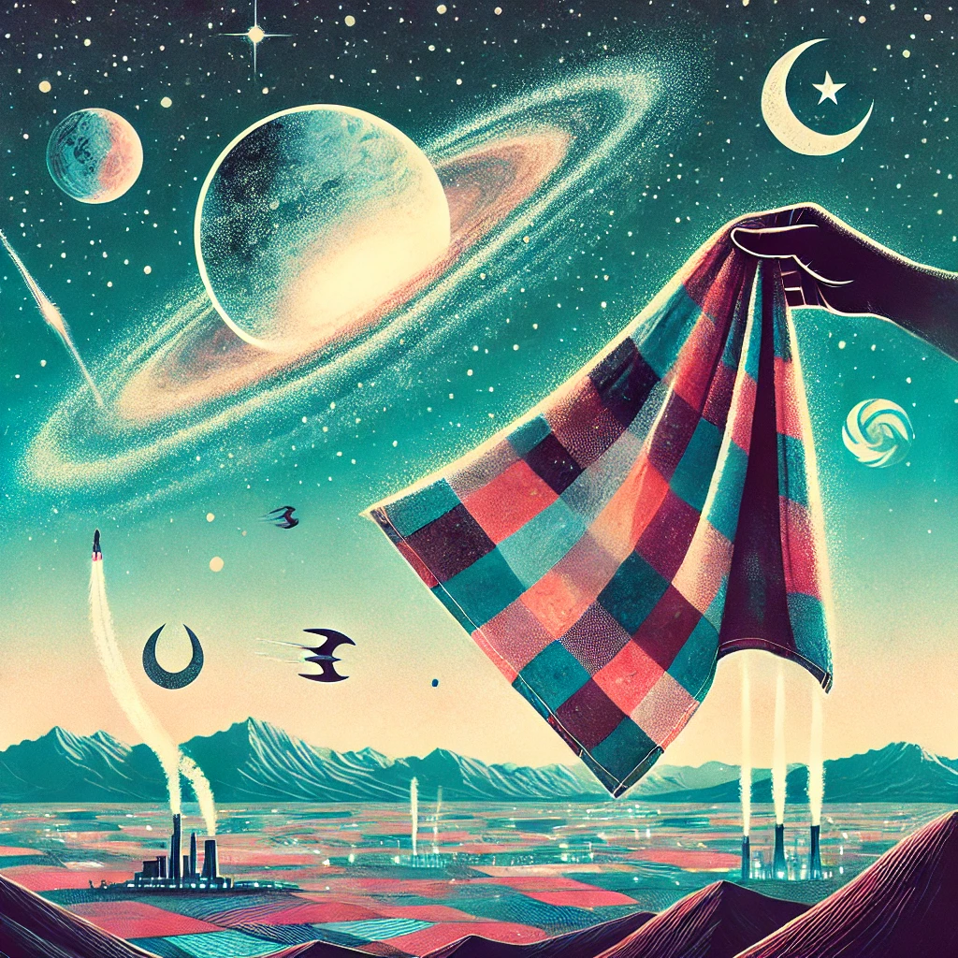
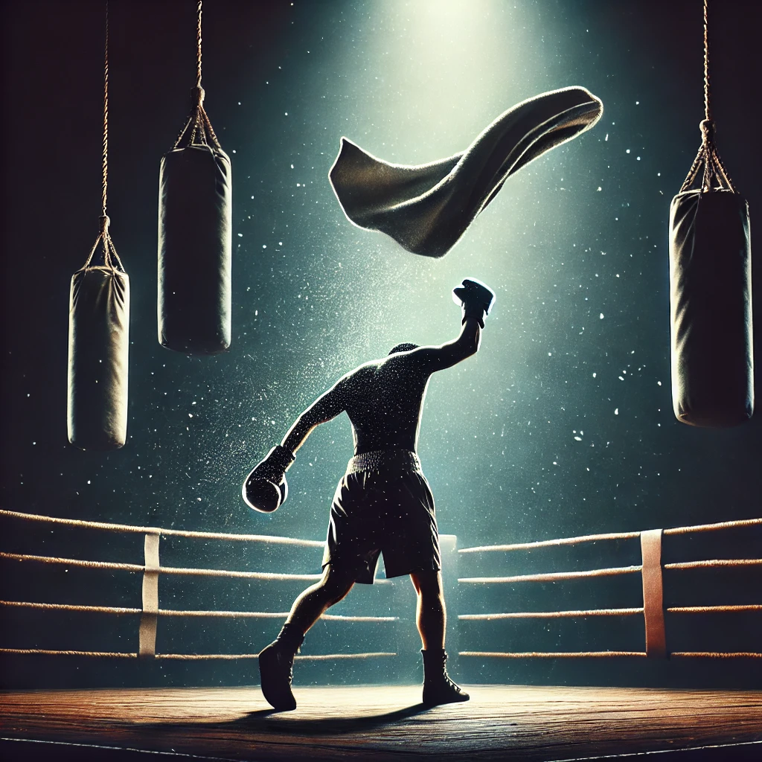
- Literal: Throw in the towel - Elaborative: A person throwing a towel into a boxing ring, symbolizing giving up or surrendering in a dramatic scene.
Literal Prompt vs Elaborative Prompt (ChatGPT)
Notes:
This is an example output of ChatGPT with. You can see the difference. On the left side is the short or literal prompt. The image looks like waving a handkerchief to space. On the right side is the elaborative prompt. The image describes the meaning of the metaphor more accurately.

Slide 8
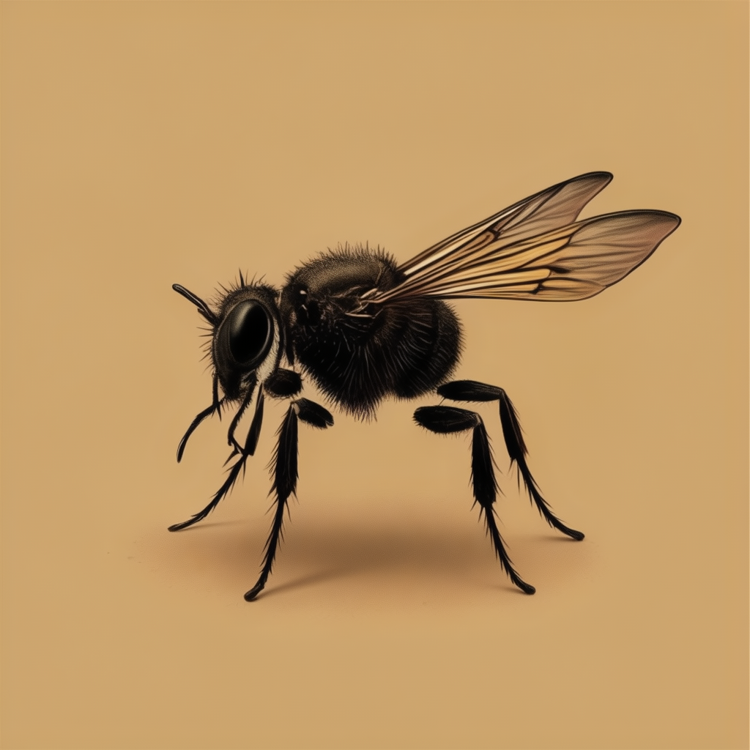
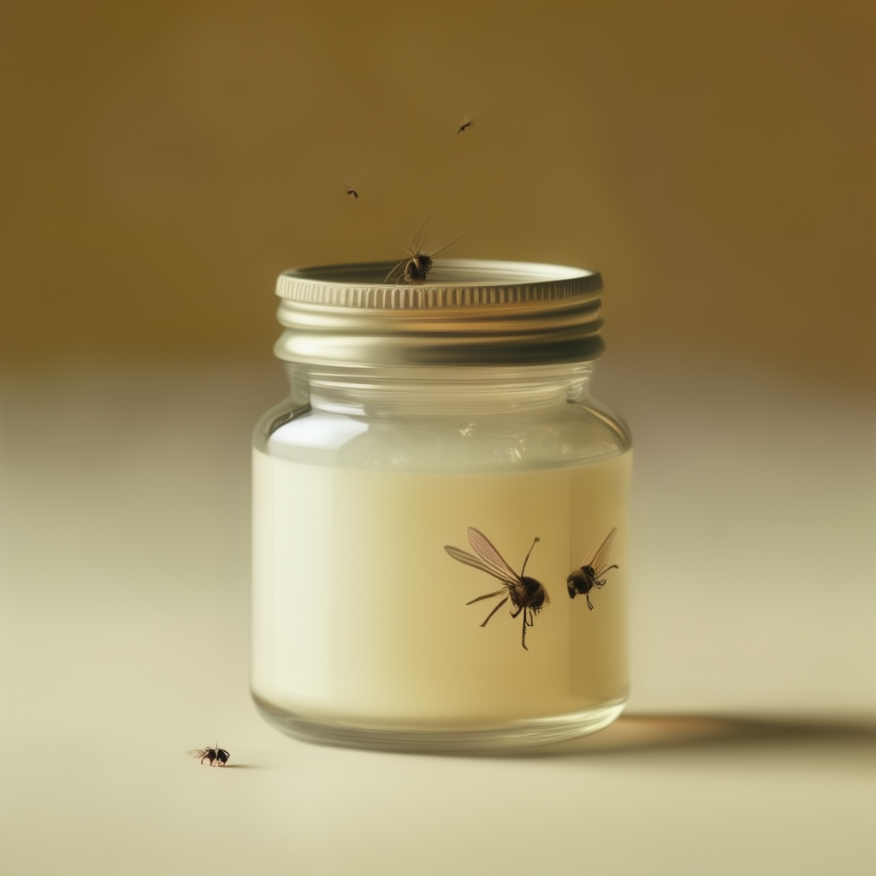
- Literal: Find a fly in the ointment - Elaborative: A pristine jar of ointment with a tiny, annoying fly buzzing around it, symbolizing a minor but irritating problem in an otherwise perfect situation.
Literal Prompt vs Elaborative Prompt (SD Cascade)
Notes:
This is another example from SD Cascade. On the left side we only have huge fly, there is no ointment or similar. On the right, the image looks much better.

Slide 9
Language bias
100 English metaphors and 100 German counter-part
(different literal translation but similar deeper meaning)
To butter someone up - Jemandem Honig ums Maul schmieren.
Keep your fingers crossed - Die Daumen drücken.
100 baseline text (simple sentence with clear meaning ) and their German translation
Notes:
To compare the performance of both image and CLIP models, we prompts in both English and German.
We have 100 English metaphors and 100 German counter-part, which means they have the same deeper meaning but different literal translations.
Additionally, we also use 100 simple sentences (and German translations) to test the baseline.

Slide 10

Experiment
4 models: ChatGPT, SD1.5, SDXL, SDCC
6 set of prompts:
100 metaphors in English (short prompt)
100 elaborations in English (long prompt)
100 metaphors in German (short prompt)
100 elaborations in German (long prompt)
100 baseline sentences in English (not for chatGPT)
100 baseline sentences in German (not for chatGPT)
22 sets of 100 images = 2200 images.
Cosine similarities are calculated pair-wise on the CLIP models’ embedding (vectors of size 768).
Notes:
In the experiment, we have 4 models and 6 prompt variants, each with 100 images. There are not baseline images for ChatGPT mostly due to time constraints and requirements.
The result is 2200 images.
Cosine similarities are calculated pair-wise using all three CLIP models.
Their embedding out are vectors of size 768.

Slide 11
Text Similarity using Jina-CLIP (Intra-modal)
Relatively high score with intra-modal embedding
“A horse running slowly through a field of flowers”
“A horse running quickly through a flower fields”
Similarity score: 0.931
“The car broke down on the highway, causing a significant delay”
“The vehicle malfunctioned on the freeway, resulting in a major holdup”
Similarity Score: 0.597
“A horse running slowly through a field of flowers”
“A cat chasing a mouse in a dark room”
Similarity Score: 0.221
Notes:
So, how does a similarity score using CLIP embedding look like? I will some you some example.
First, for text-to-text similarity score (Intra-modal can be either text-to-text or image-to-image).
The first pair are 2 very similar sentences, {say sentences}, they have similarity score of 0.93.
The seconds means the same but uses different words. CLIP gives us a respectable score of 0.59.
The last pairs are different sentences, so we have a score of 0.22.
These scores are reasonable.

Slide 12
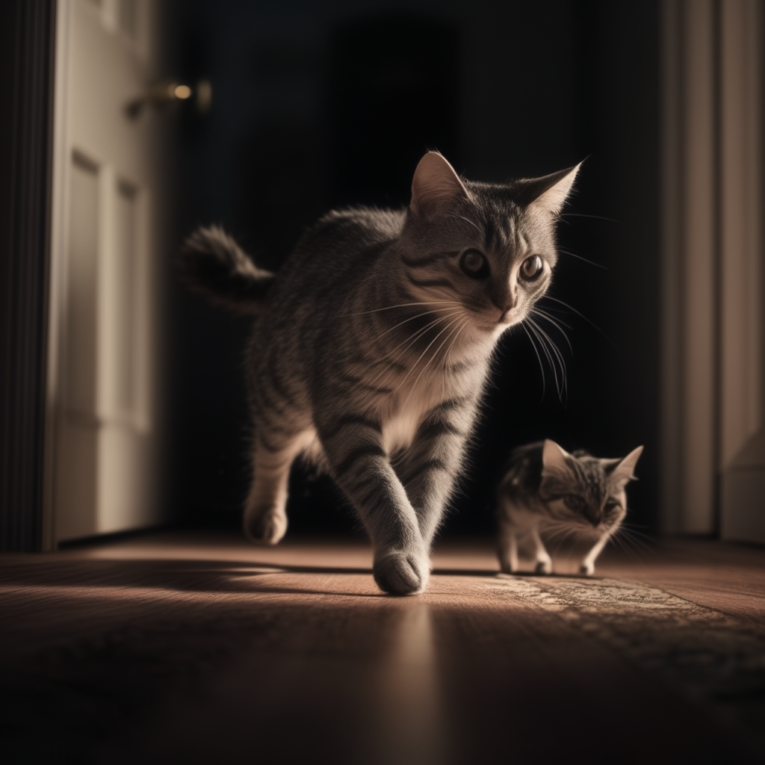
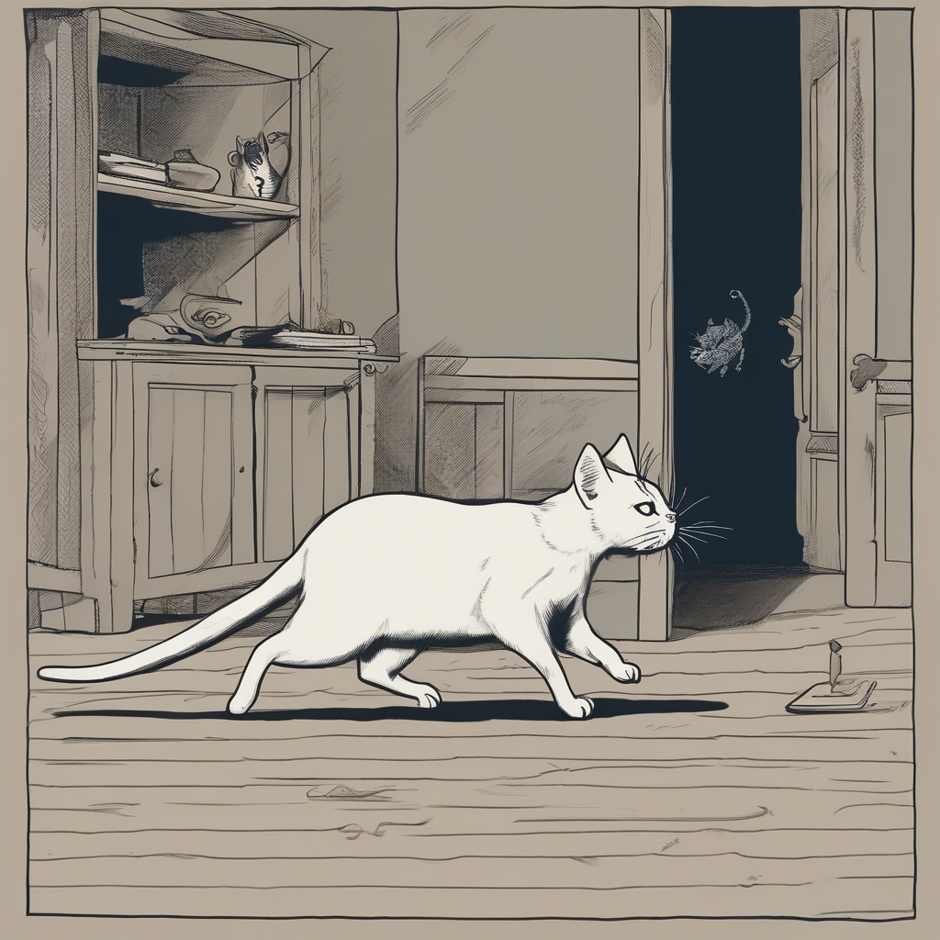
Prompt: A cat chasing a mouse in a dark room.
BASE CLIP Score: 0.773
Intra-Modal (Image-Image)
Notes:
Now, let’s look at some image-to-image score (also intra-modal):
These two images come from 2 different models, I think its XL on the left and CC on the right, using the same prompt {say prompt}.
Yeah, this is not a mouse, and this here looks like a scorpion or an alien face-hugger.
CLIP gives a score of 0.773, which is not bad, considering the styles of the image are quite different.

Slide 13
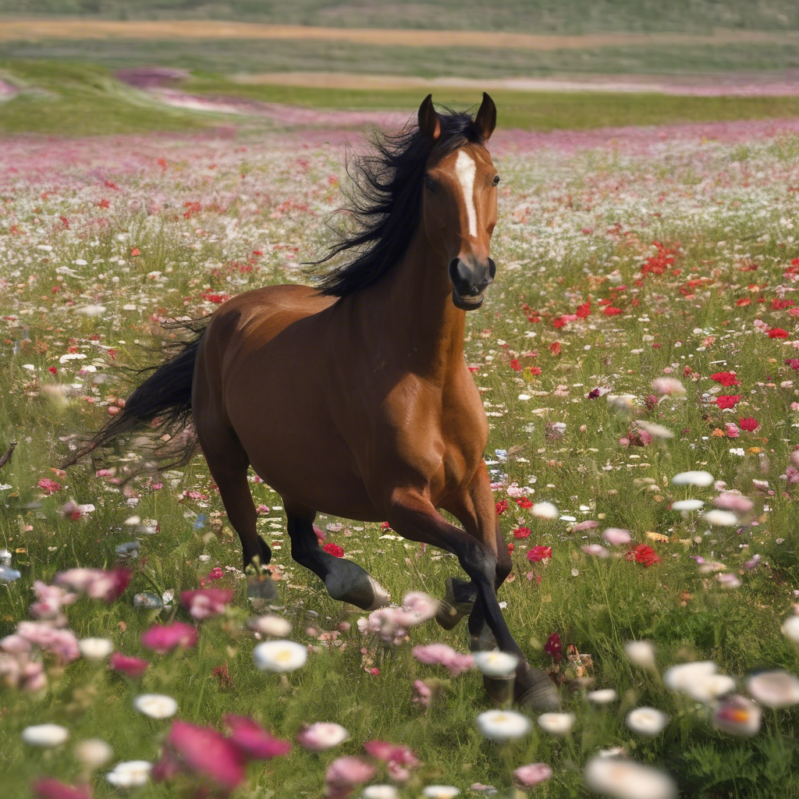
A cat chasing a mouse in a dark room
A Horse Running Through A field of Flowers
Image-to-Image Score: 0.449
Intra-Modal (Image-Image)
Notes:
These two images are quite different, so they have a score of 0.449.

Slide 14
A cat chasing a mouse in a dark room. A Horse Running Through A field of Flowers.
Text-to-Image Score: 0.295 Text-to-Image Score: 0.379
Cross-Modal (Text-Image)
Notes:
Here we measure the score between an image and its prompt. The scores is quite low, right? You may wonder why.

Slide 15
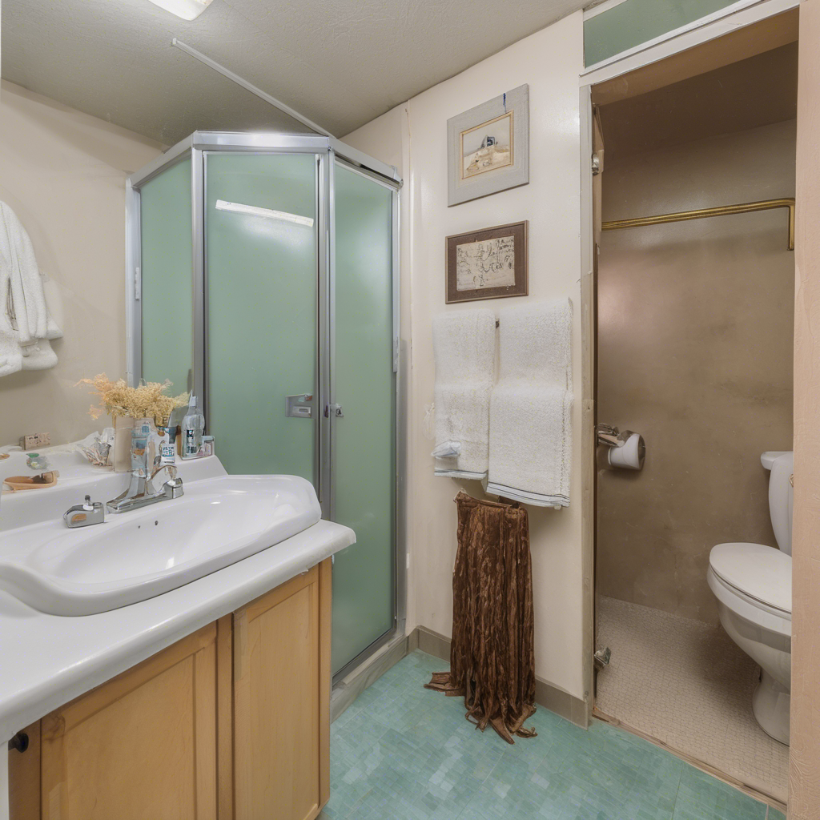
Inter-Modal
Text and images use different encoders
CLIP is trained to align text-image pair, but not necessarily to maximize the cosine similarity score.
A similarity score of around 0.3 is already considered a strong text-image pair in the context of CLIP.
The score is multiplied by 100 before entering softmax.
A score of 0.3 is 99.3% match vs a score of 0.25.
A bathroom with a toilet, sink, and shower
Similarity Score: 0.263
Notes:
A few considerations regard this low scores.
Text and image use different encoders and embedding spaces.
CLIP’s training objective is to align text-image pair, not maximize the cosine similarity score.
A score of around 0.3 is already considered a strong match in the context of CLIP.
Since the score is multiplied by 100 before entering a softmax layer, consider classifying two images with scores of 0.3 and 0.25. The probability for the image with a score of 0.3 is already around 99.3%.

Slide 16
Text-Image
Open AI Base CLIP |  | ChatGPT | SD.15 | SDXL | SDCC
Baseline | English | N/A | 0.2878 | 0.3176 | 0.3126
 | German | N/A | 0.2528 | 0.2643 | 0.2662
Elaborative prompts | English | 0.3139 | 0.2810 | 0.3178 | 0.3102
 | German | 0.2540 | 0.2431 | 0.2515 | 0.2598
Literal prompts | English | 0.2749 | 0.2414 | 0.2587 | 0.2540
 | German | 0.2448 | 0.2371 | 0.2310 | 0.2309
Notes:
The overall trend is that:
English gives better score than German. This suggests the models understand English better.
Elaborative prompts are better than literal prompts, since the image models have more data to work with.
ChatGPT is usually the best, following by SDXL and SDCC, those two are often very close to each other. SD1.5 ranks a distant fourth place.
The Base CLIP surprisingly performs quite good in German, which indicates that the original training data could have included a fair amount of German text.

Slide 17
Text-Image
Roberta Clip (Multilingual) |  | ChatGPT | SD.15 | SDXL | SDCC
Baseline | English | N/A | 0.2420 | 0.2761 | 0.2741
 | German | N/A | 0.1837 | 0.2409 | 0.2421
Elaborative prompts | English | 0.2835 | 0.2399 | 0.2763 | 0.2788
 | German | 0.2761 | 0.1861 | 0.2348 | 0.2317
Literal prompts | English | 0.2212 | 0.1917 | 0.2034 | 0.2047
 | German | 0.1972 | 0.1600 | 0.1753 | 0.1818
Notes:
The overall trend is that:
English gives better score than German
Elaborative prompts are better than literal prompts, since the image models have more data to work with.
ChatGPT is usually the best, following by SDXL and SDCC, which are often very close to each other. SD1.5 is at a distant fourth place.
The Roberta CLIP surprisingly performs quite good in German, but its German seems a bit lower than the Base CLIP. But this model supports a lot of languages. And again, in CLIP context, absolute score is not as important as relative score.

Slide 18
Text-Image
Jina CLIP |  | ChatGPT | SD.15 | SDXL | SDCC
Baseline | English | N/A | 0.2152 | 0.2810 | 0.2780
 | German | N/A | 0.1241 | 0.1643 | 0.1499
Elaborative prompts | English | 0.2763 | 0.1797 | 0.2622 | 0.2682
 | German | 0.1598 | 0.1051 | 0.1434 | 0.1349
Literal prompts | English | 0.20050 | 0.1310 | 0.1621 | 0.1495
 | German | 0.1047 | 0.0734 | 0.0817 | 0.0793
Notes:
The overall trend is that:
English gives better score than German
Elaborative prompts are better than literal prompts, since the image models have more data to work with.
ChatGPT is usually the best, following by SDXL and SDCC, which are often very close to each other. SD1.5 is at a distant fourth place.
Jina CLIP performs notably worse in German, likely because it was re-trained mostly in English, aligning with its paper.

Slide 19
Text-Image
Language Comparison: German languages had slightly lower similarity scores (significantly in case of Jina Clip), suggesting a bias in training data.
Prompt Type Comparison: Elaborative texts generally led to higher similarity scores compared to direct metaphors, indicating that more descriptive prompts might help models generate better images.
Model Performance:
SD1.5 is significantly worse.
ChatGPT is mostly the best.
CLIP Model:
Jina had very low German score.
OpenAI has a slight bias towards English, but still good in German.
Multilingual Clip seems to perform reliably well between English and German.
Notes:
So this is the summary of what I have just explained.
English better than German
Long prompts better than short prompt

Slide 20
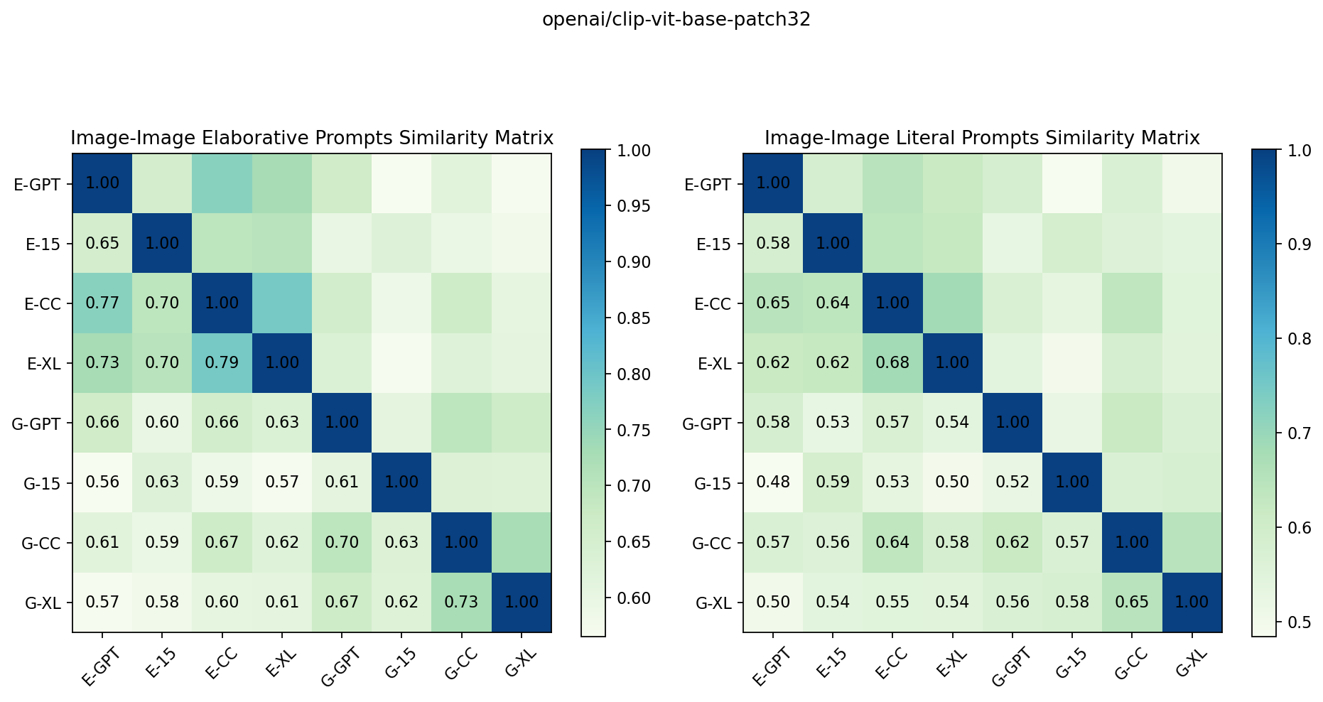
Image-Image

Slide 21
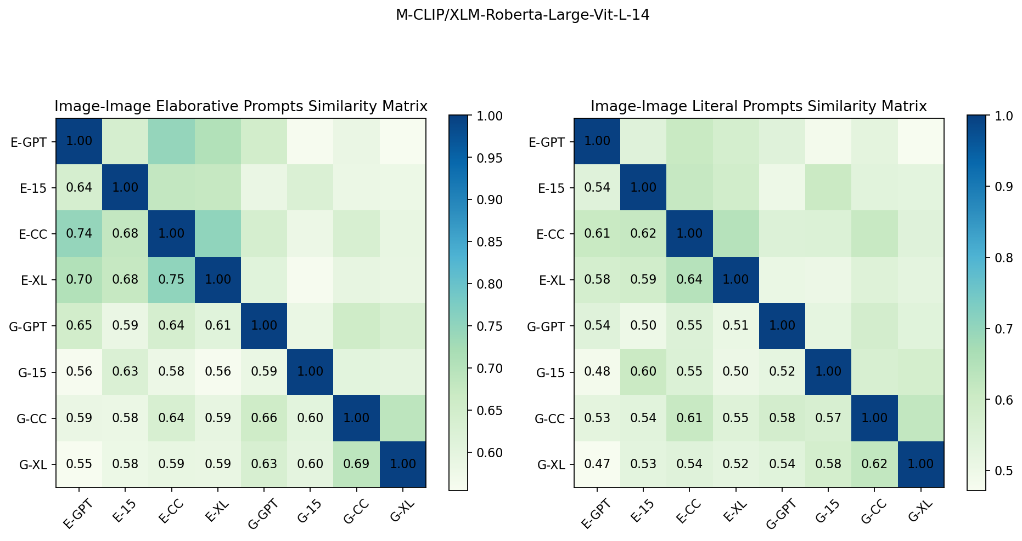
Image-Image

Slide 22
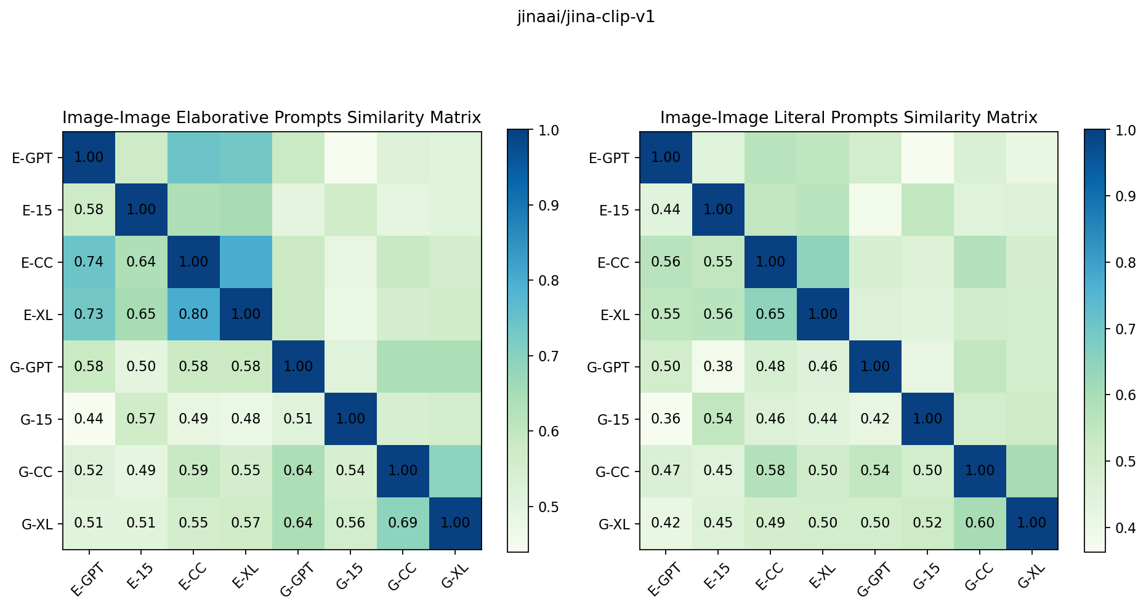
Image-Image
Notes:
So the results here are quite similar across the board for all three CLIP models.
The score between the English images, which is the top-left triangle here, are the highest, suggesting that the meaning of the English text are captured most accurately.
The score between the German images, which is the bottom triangle here, are the lower, suggesting that the meaning of the German are captured not as well as English.
The score between English and German, which is the bottom-right square here, is the lowest, suggesting the models have trouble connecting the deeper meanings of metaphors, because remember the German metaphors have the same deeper meaning, but different literal meaning.

Slide 23
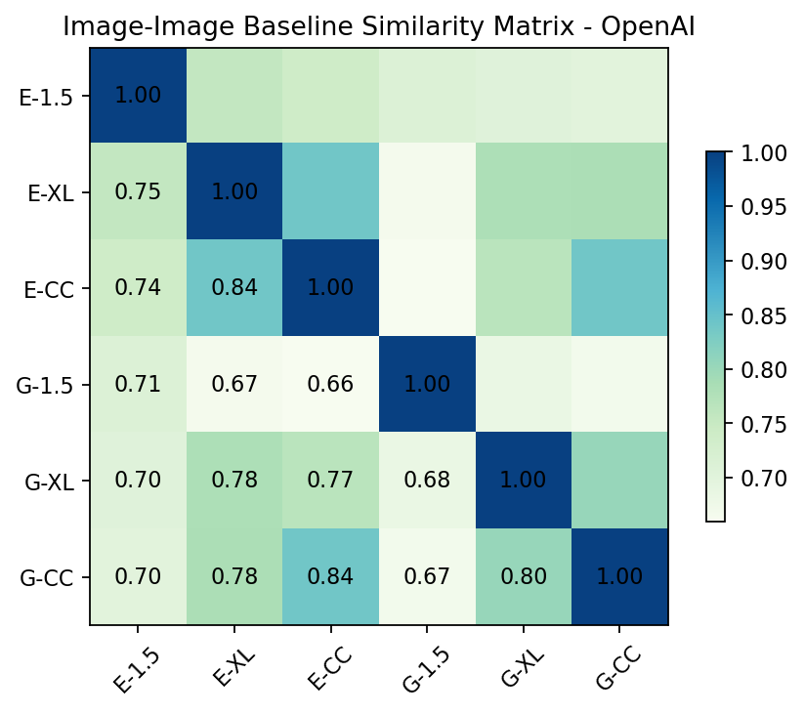

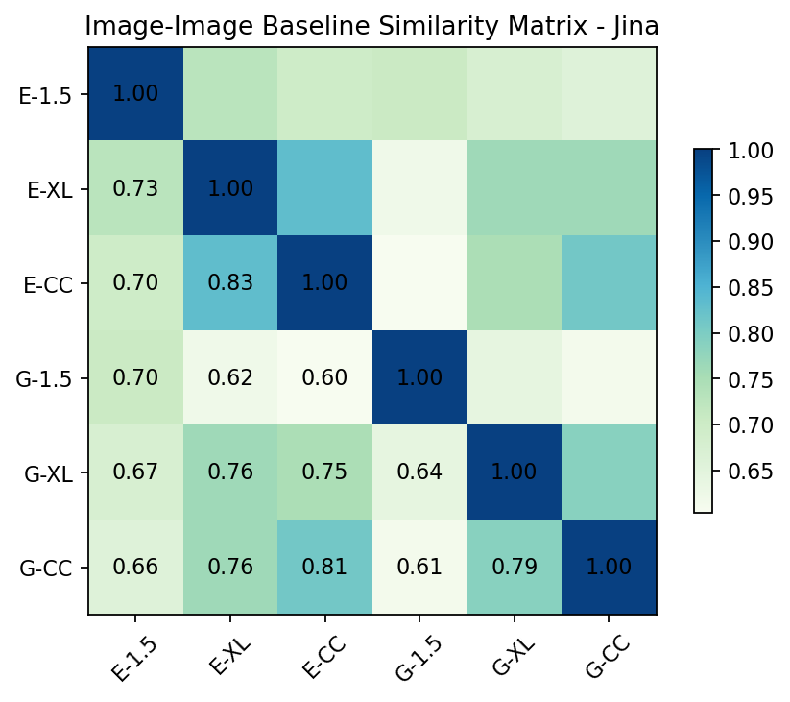
Baseline Image-Image
Notes:
The score of baseline text are higher than the score the metaphors, which is understandable because they have the same literal meaning and no deeper meaning.

Slide 24
Conclusion
SD1.5 consistently scores very low, given its smaller size and age, while ChatGPT looks to be the best.
Higher overall score between English image sets shows that the image generation models understands English markedly better than German.
Cross language scores are notably lower, suggesting the metaphors deeper meaning are not understood well by the models.
Metaphorical texts seem to be harder for the models to visualize.

Slide 25

This image is AI-generated

Slide 26
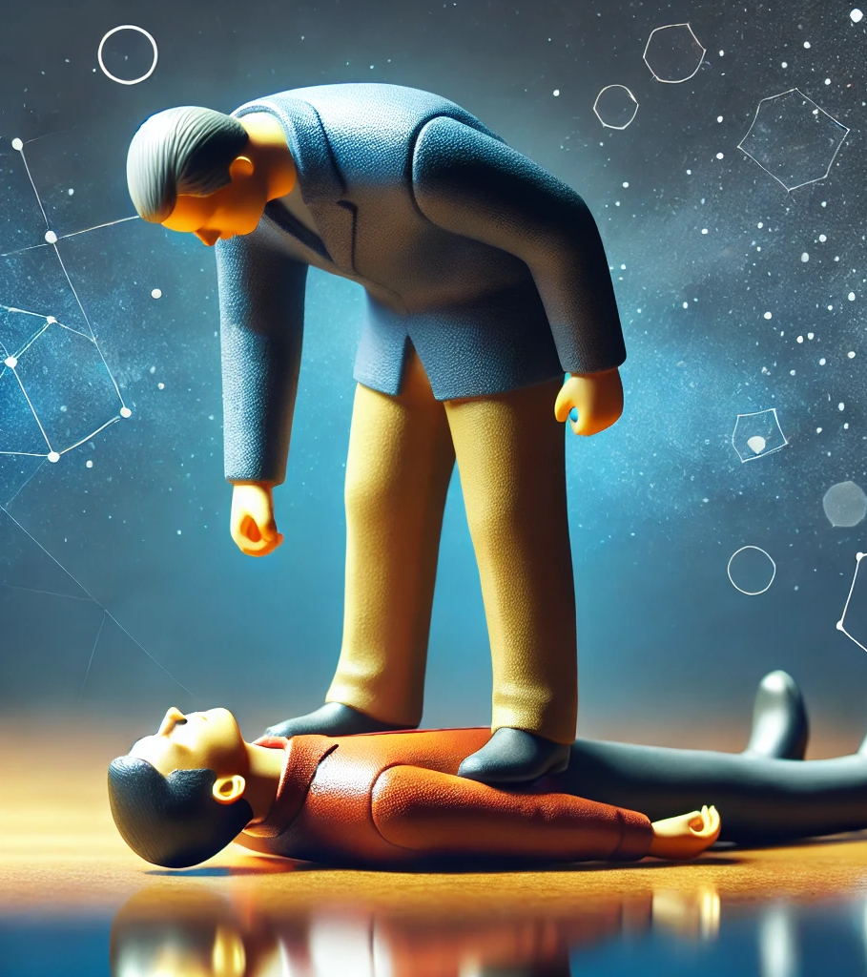
ChatGPT min score
Put an end to someone or something.
Score: 0.162

Slide 27
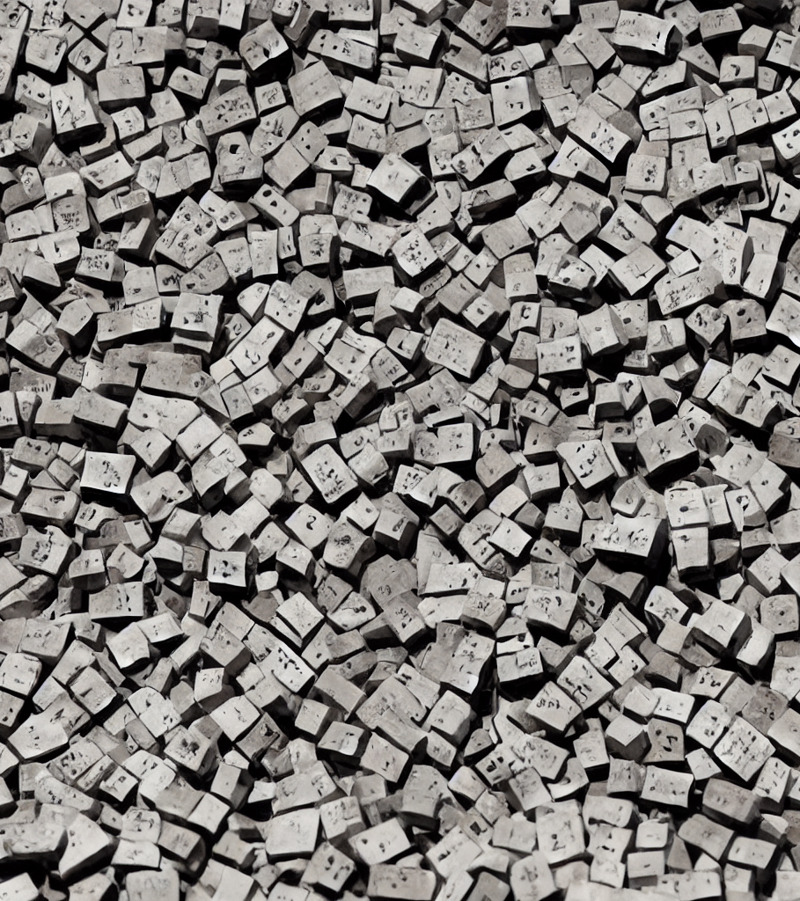
SD 1.5 min score
Einen Zahn zulegen.
Score: 0.007

Slide 28

SD Cascade max score
To tempt fate.
Score: 0.383

Slide 29
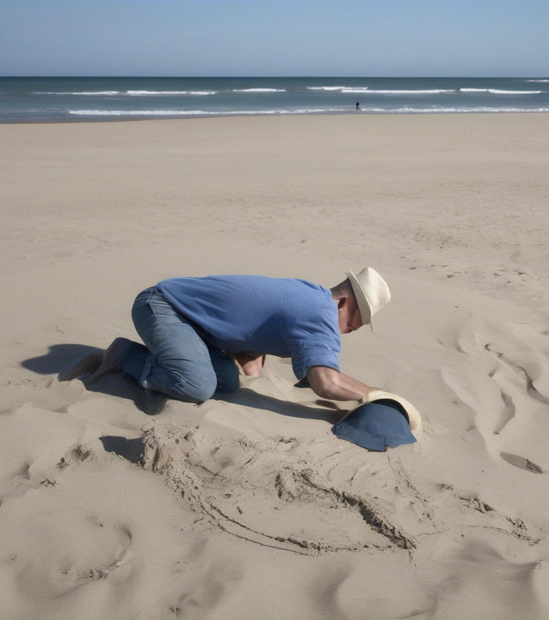
SD XL max score
Den Kopf in den Sand stecken.
Score: 0.286

Slide 30
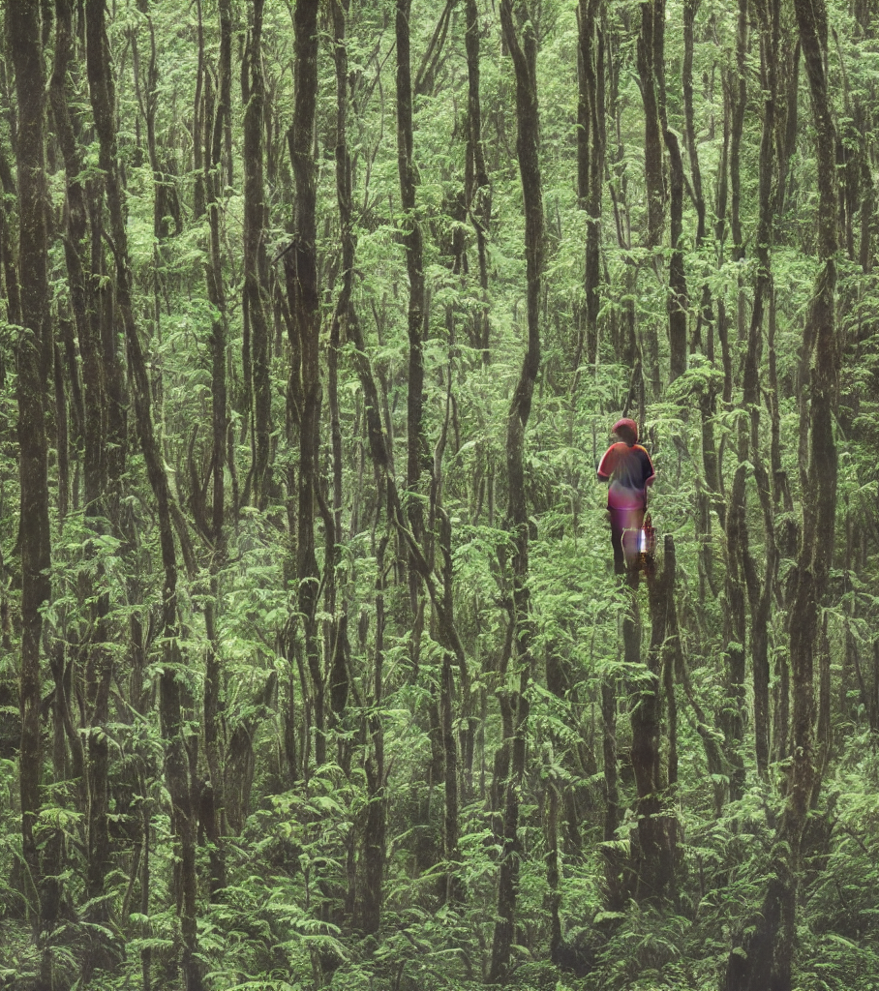
SD 1.5 max score
Can't see the forest for the trees.
Score: 0.31

